Slide 1
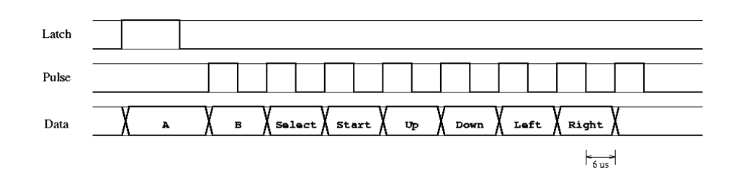
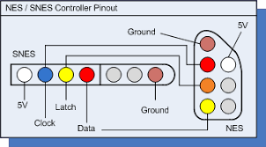
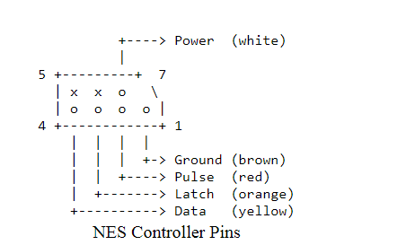
NES controller introduction
Need +5V power source
Frequency: Nintendo polled the controller at 60 Hz
Problem: FPGA is 3.3V based…
Documentation: https://tresi.github.io/nes/

Slide 2
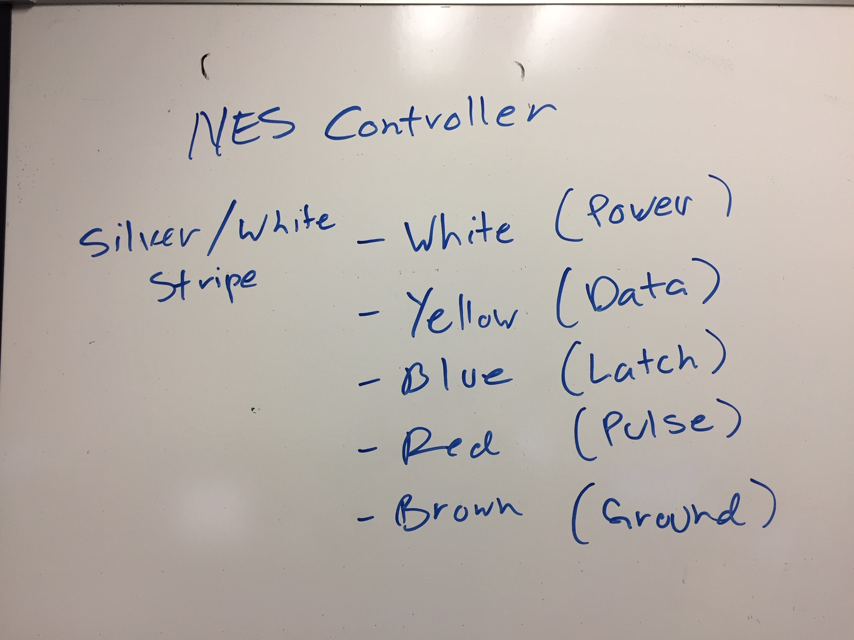

Slide 3
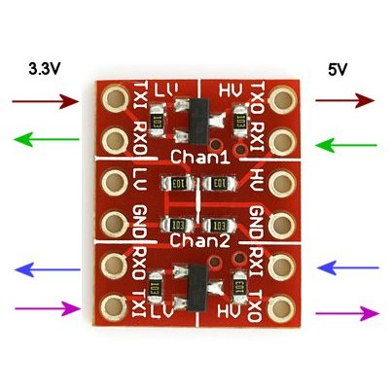
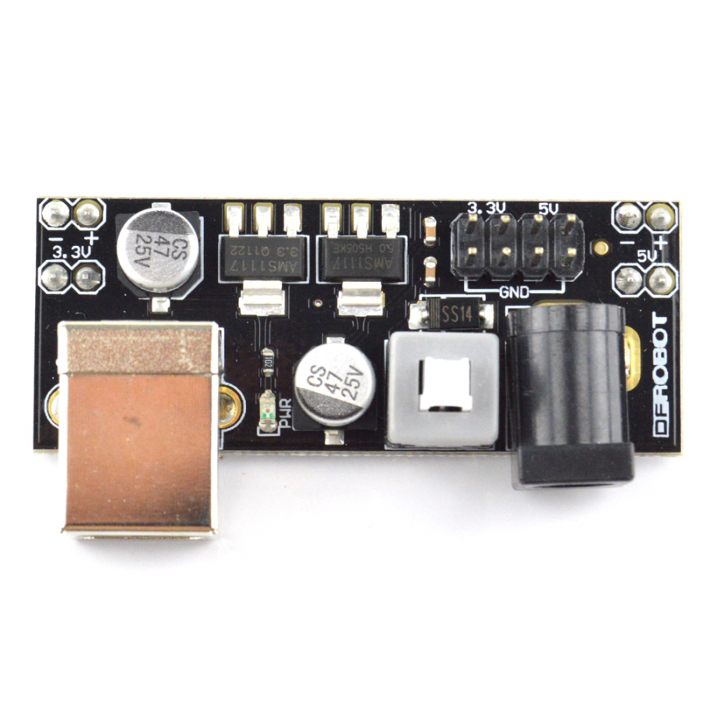
Solution!
BOB-08745 Level Converter
not needed? See next slide
Breadboard power supply kit
5 volts needed to power SNES controller
Can use USB cord to supply 5 volts to this board
Could we somehow just break out the 5 volts
from the USB cable, and skip this board?
see slide 4

Slide 4
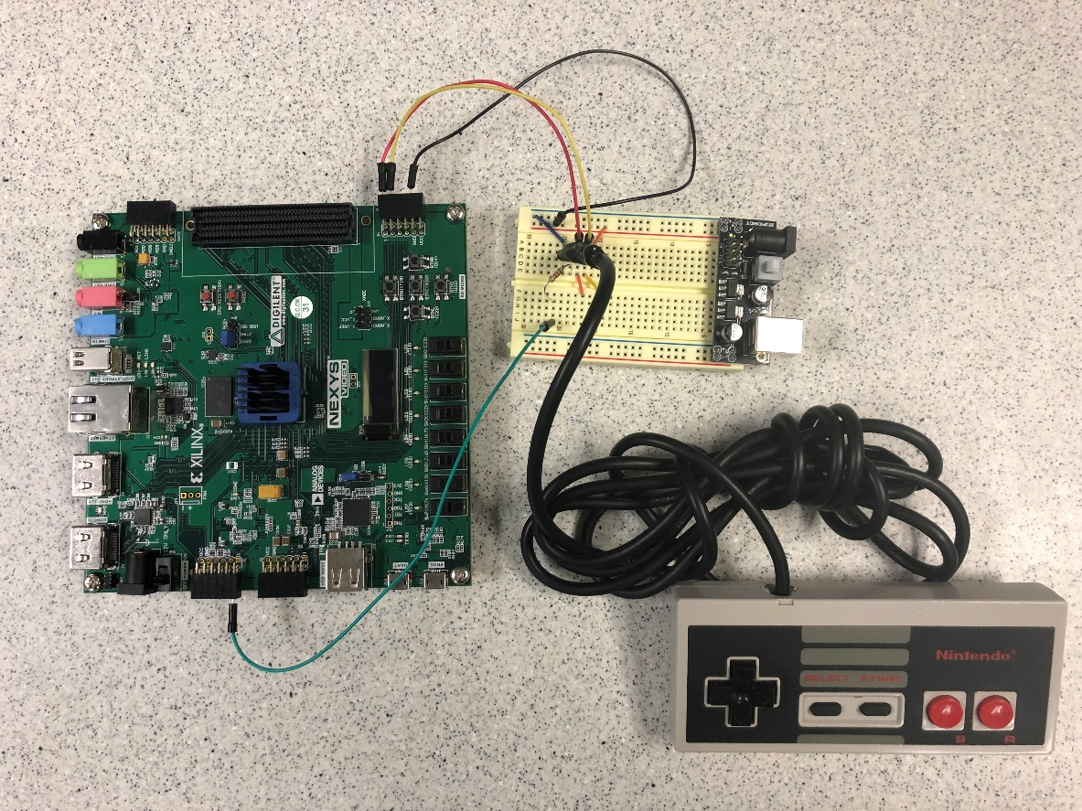
NES Controller
Found we did not need the Level Converter board
Used 120 ohm resistor between the SNES 5 volt Data pin and the FPGA 3 volt input pin
Just hooked the FGPA 3 volt output pins directly to the SNES 5 volt latch and pulse input pins, and it worked
Some students were able to get the old NES controllers to work with 3 volts and no 120 ohm resistors. Seems the newer SNES controllers need the 5 volts/ 120 ohm

Slide 5
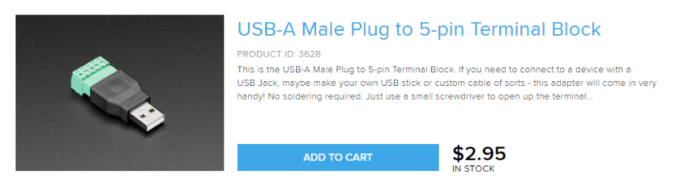
Could this provide your 5 Volts power, without the extra board?
Be careful not to short out your USB supply or laptop USB port

Slide 6
Detailed Design
Detailed design of the datapath and FSM.
Key players: BRAM, FSM, and video modules
Module | snake_datapath.vhd (FPGA hardware)
Inputs | flagClear – reg14 (1 bit) SoundEn – reg1 (1 bit) Dot1en – reg2 (1 bit) Dot2en – reg3 (1 bit) Dot1x – reg4 (10 bits) Dot1y – reg5 (10 bits) Dot2x – reg6 (10 bits) Dot2y – reg7 (10 bits) Plen – reg8 (1 bit) P2en – reg9 (1 bit) P1x – reg10 (5 bits) P1y – reg11 (32 bits) P2x – reg12 (5 bits) P2y – reg13 (32 bits) Data signal from NES → ja(3)
Outputs | Latch signal to NES → ja(1) Pulse signal to NES → ja(2) NESready signal to SDK (interrupt purposes) NES button to SDK NES button to LEDs
Behavior | The datapath is the main unit that contains majority of the sub-modules and vhdl code necessary to draw snake blocks on the correct, specified location on the monitor. Basically, the datapath takes in a block location from MicroBlaze and draws a block on the specified location with the help of BRAM and oscilloscope modules implementation.

Slide 7
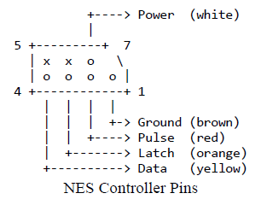
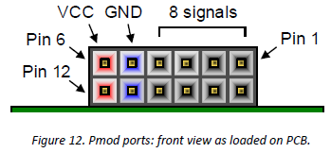
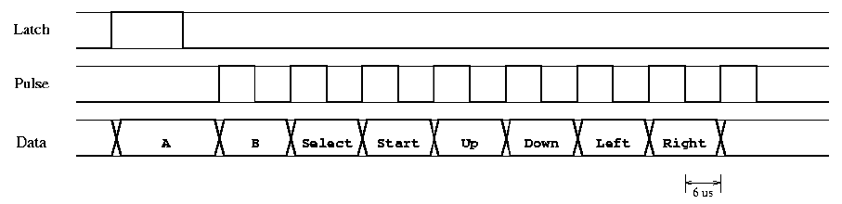
Detailed Design
Must follow timing diagram.
NES controller requires two signals generation in order respond with button press.
The one and only objective of the FSM is to generate the latch and pulse and detect data from NES.
Utilize a counter to create half-cycle delays of 6 microseconds

Slide 8
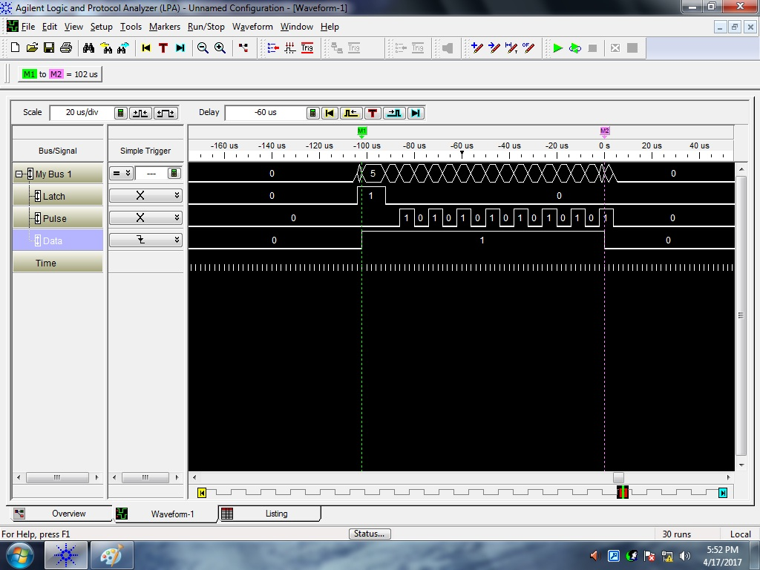
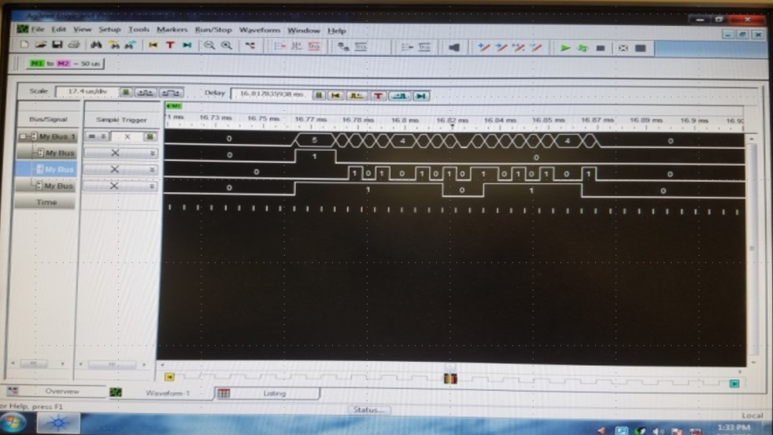
Detailed Design
Utilize logic analyzer to verify signal generation and that NES is responding.
Utilize LED to verify as well.

